Slide 1
Boo Store Api
Sequence Diagram
Author: Greyson Zhou
Version: 1.0

Slide 2
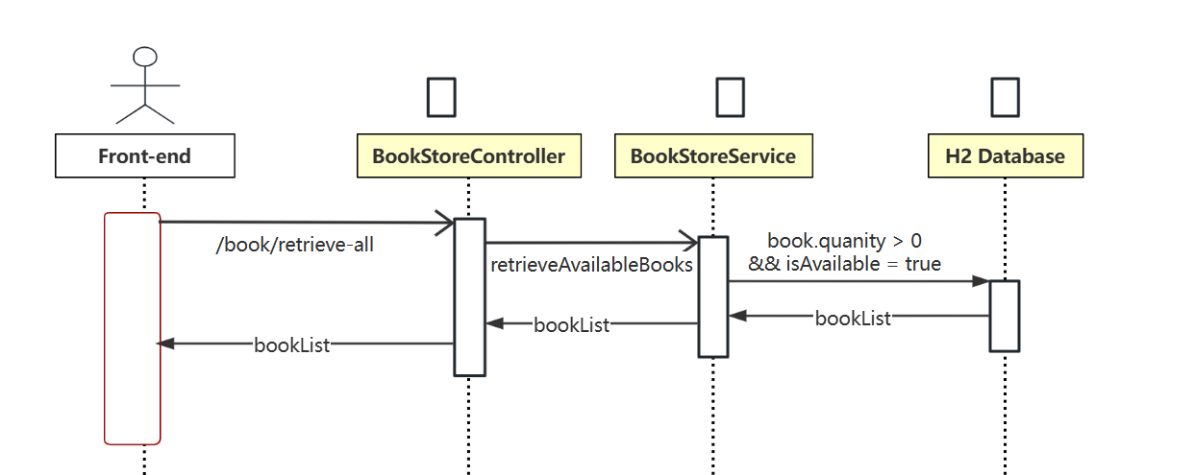
Retrieve Available Books

Slide 3
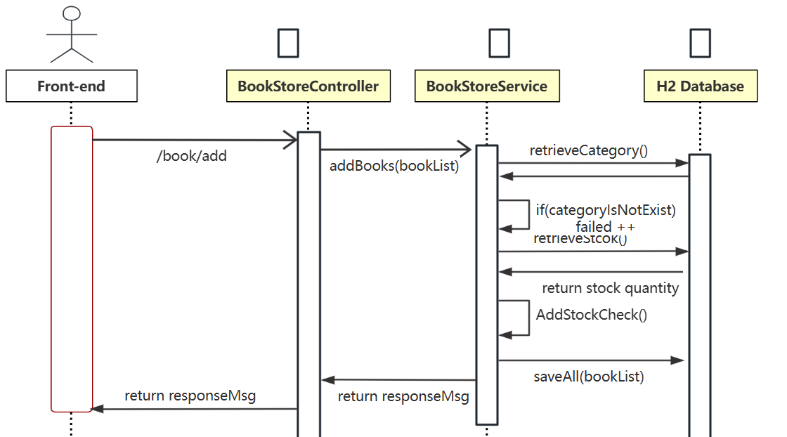
Save Books

Slide 4
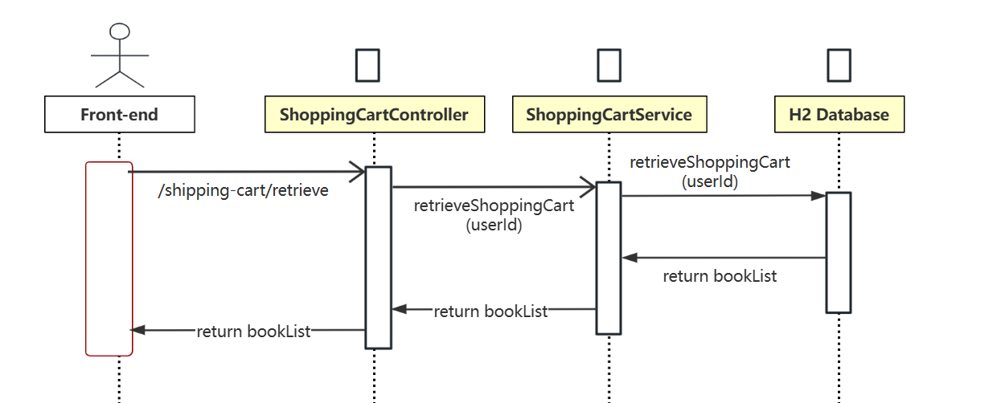
Retrieve Shopping Cart

Slide 5
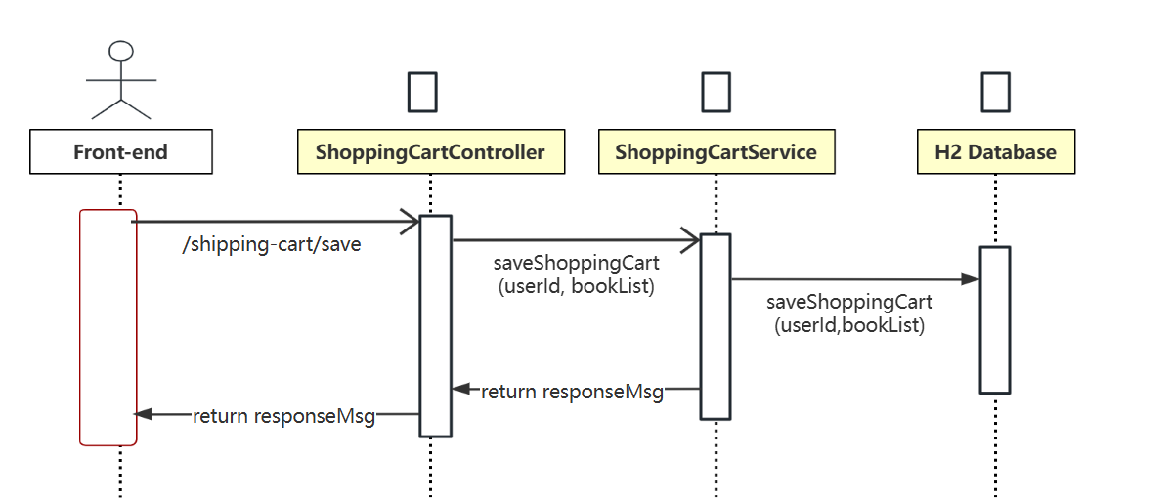
Save Shopping Cart

Slide 6
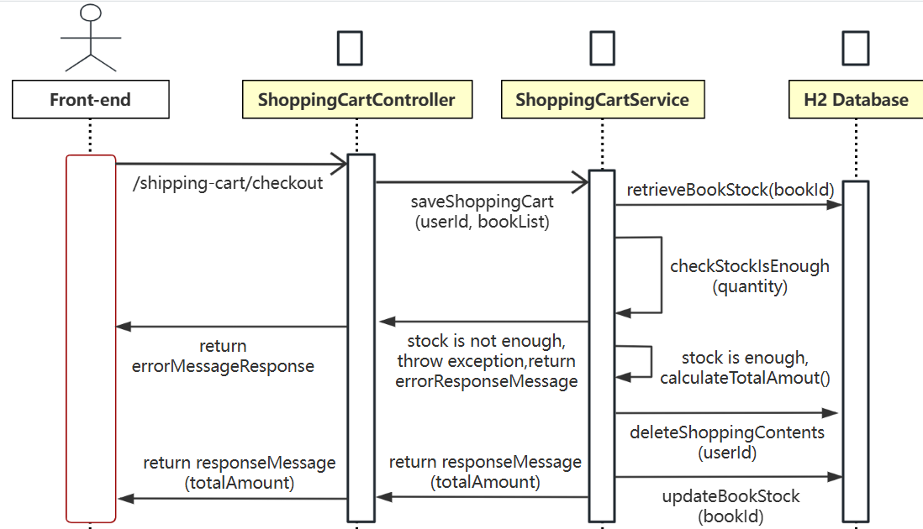
Checkout Shopping Cart

